Slide 1

BIG DATA Project
Abhishek Arya
Atul Inamdar
Bipin Pokharel
Ravindra Patil
Sahith Reddy Nalla
Sai Kruthik Reddy Paduru

Slide 2
About the Project
The objective of the project is to identify risks for a logistics company’s fleet.
Some example Analysis Done:
Risky Drivers by Speeding data
Drivers with Risk Factor > 7
Risk distribution by Cities
Predictive Analysis based on Events and Miles

Slide 3
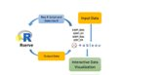
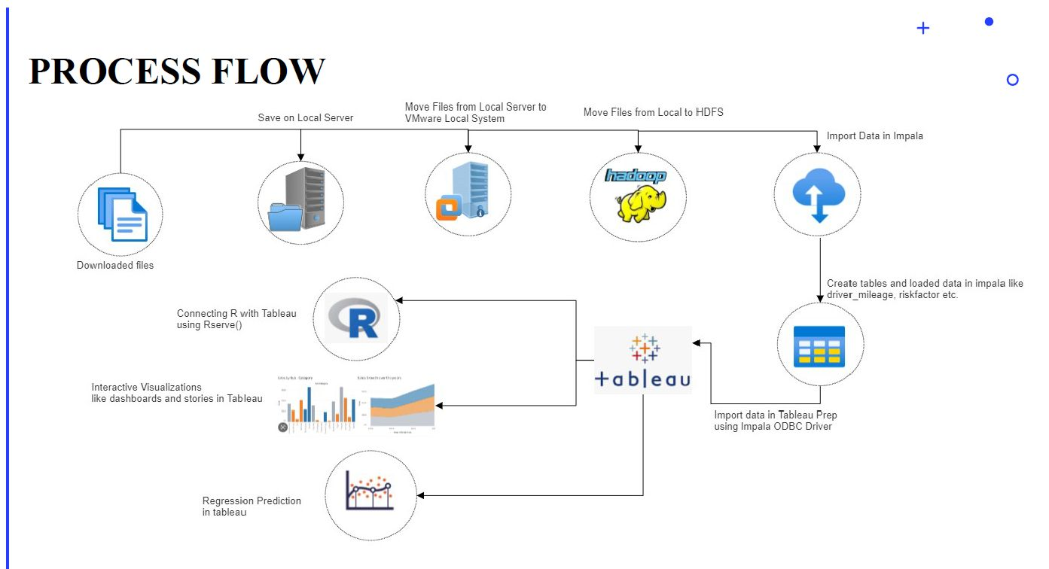






Process Flow

Slide 4
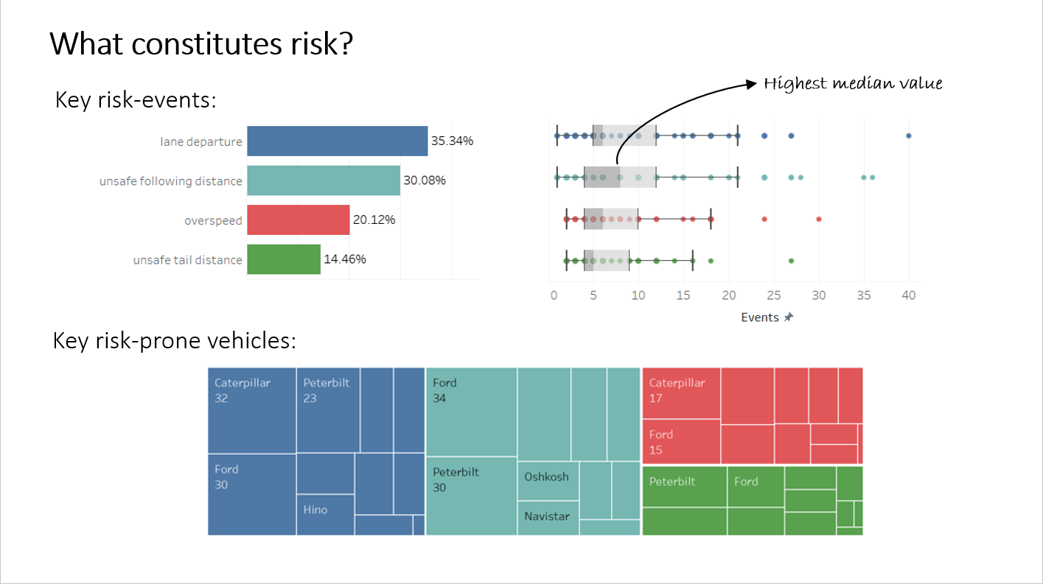
What constitutes risk?

Slide 5
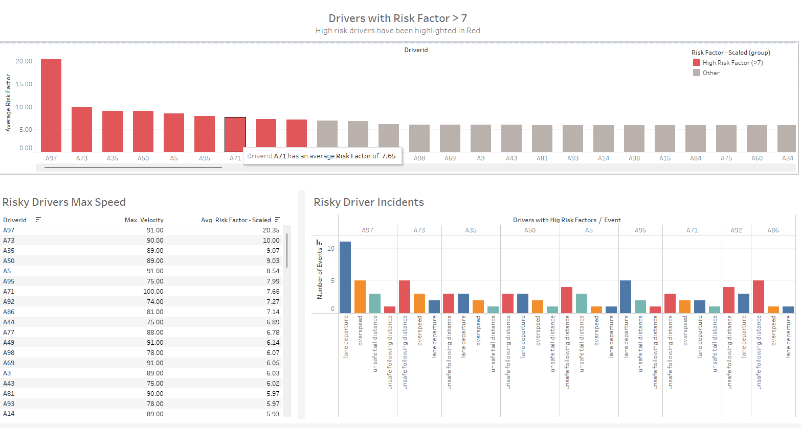
Who are at risk?

Slide 6
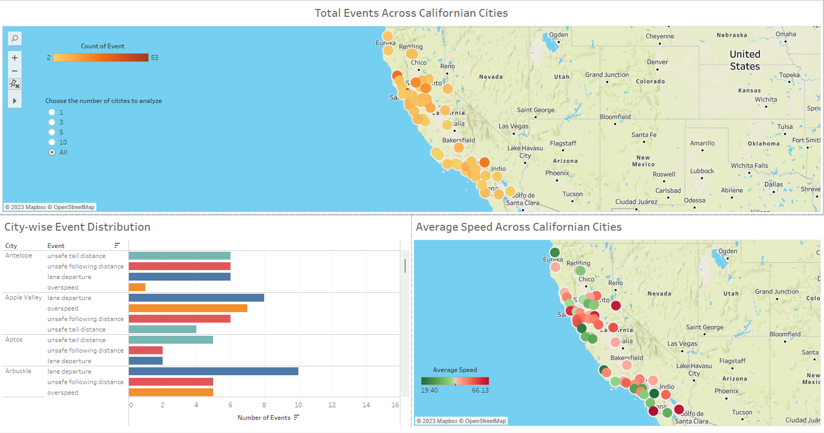
Where is the highest risk?

Slide 7
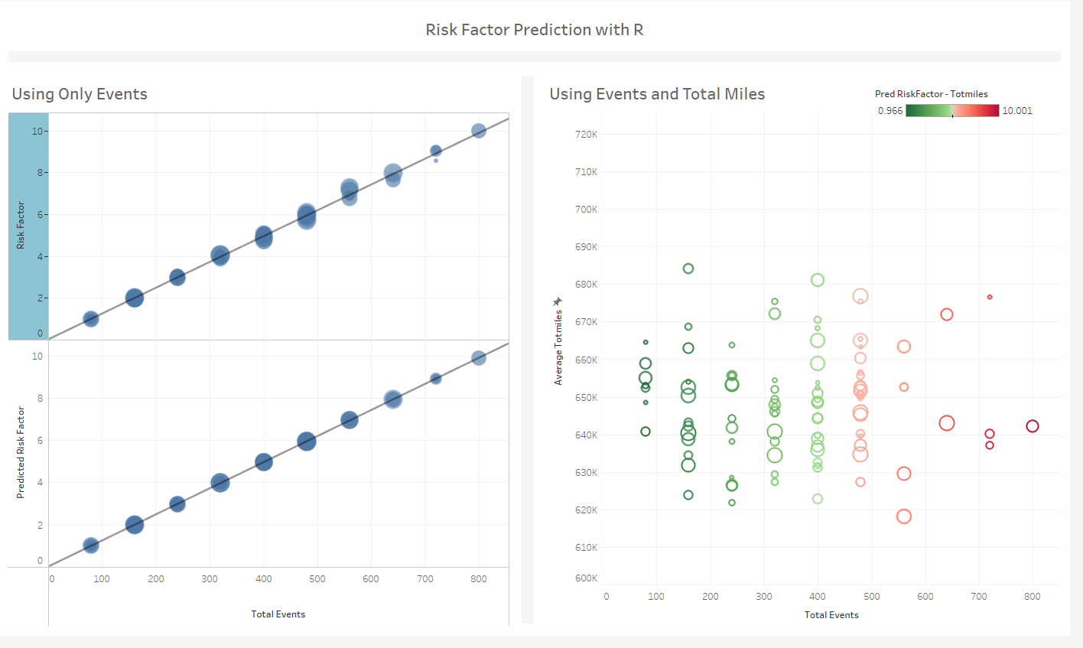
Predictive Analysis

Slide 8
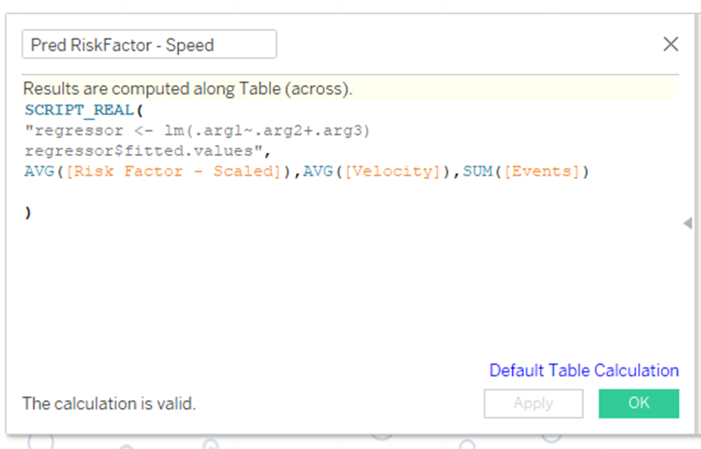
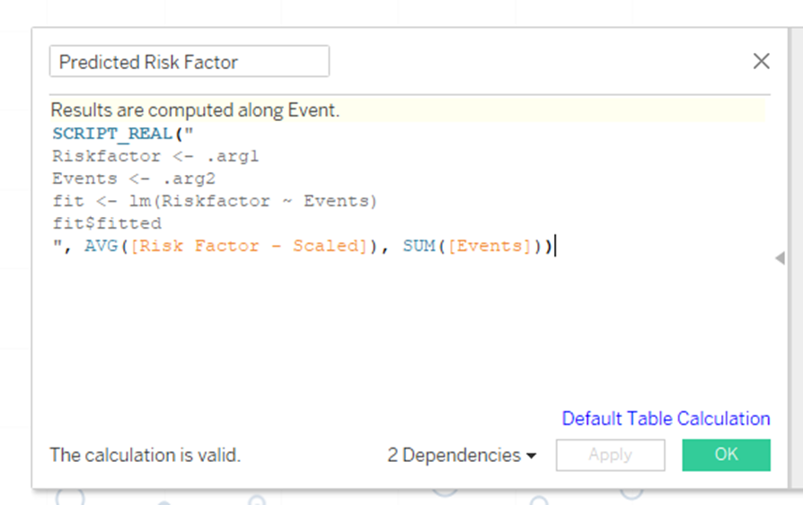
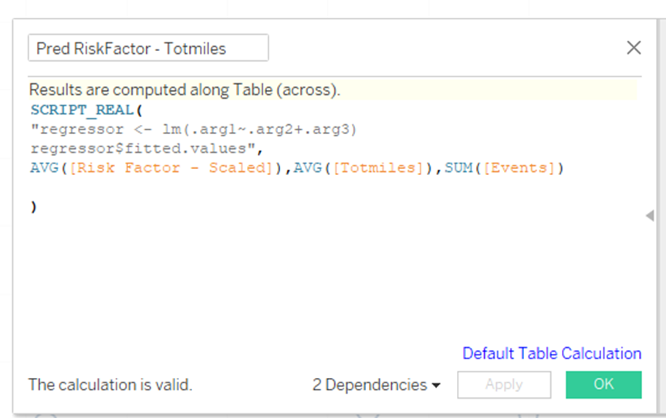
R- code

Slide 9

Questions?

